Slide 1


Data Science with R from A to Z
by Bryan Cafferky
Course Content @
https://github.com/bcafferky/shared/tree/master/DataScienceFromAtoZ

Slide 2


About Bryan Cafferky…
Data Solutions Enabler (TSP)
Decades of IT Experience in health care, insurance, banking, and ecommerce.
Microsoft MVP.
Author of Pro PowerShell for Database Developers.
Founded and lead PASS Chapter The RI Microsoft BI User Group and The SNE R User Group.
Frequent presenter at technical conferences and user groups.
bryan256@msn.com
www.sql-fy.com
https://www.linkedin.com/in/bryancafferky
@BryanCafferky – follow me!
Subscribe to me on YouTube!

Slide 3

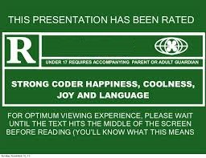
For Language and graphics
Course Content @
https://github.com/bcafferky/shared/tree/master/DataScienceFromAtoZ

Slide 4
Today’s Goals
Learn What R is?
Basic Programming Using the RStudio IDE
Data Access
Predictive Analytics
SQL Server/R Integration
Supercharging Power BI with R
Azure Machine Learning with R
Course Content @
https://github.com/bcafferky/shared/tree/master/DataScienceFromAtoZ

Slide 5
Schedule
Morning: 9:00 AM – 11:45 AM
Afternoon: 1:00 – 4:00 PM
Part 1
Introduction/Getting Started
RStudio & Packages
Part 2
R Programming
Statistics
Part 3
Data Quality and Wrangling
Part 4
SQL Server/R Integration
Part 5
Predictive Analytics
Supercharging Power BI with R
Part 6
Azure Machine Learning with R
Lunch/Labs: 11:45 AM – 1:00 PM
Labs: 4:00 PM – 5:00 PM

Slide 6

Time to Find Your Inner Child!

Slide 7
What is R?
R is an open source language for Data Science.
scr_opening_speech.R

Slide 8

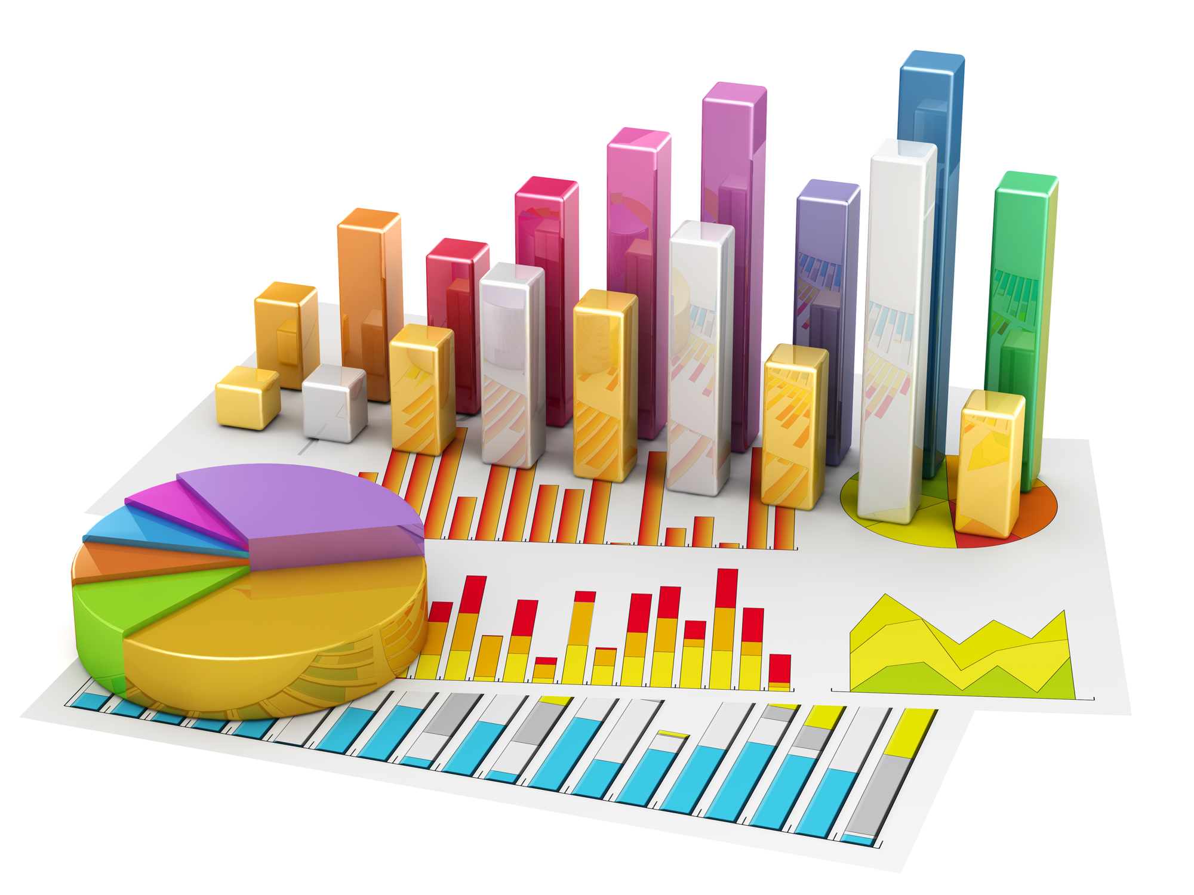


When to Use R?
Statistics
Visualization
Analysis
Exploration

Slide 9


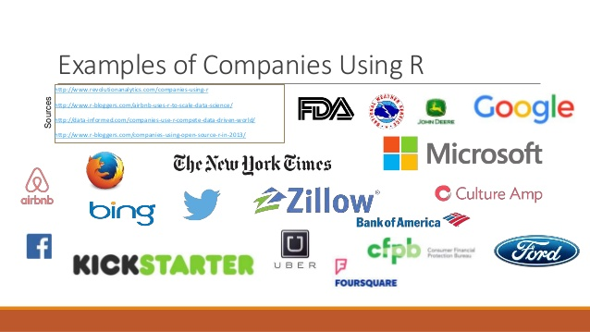

Why Use R?
Career
Sharing

Slide 10


Integrated Development Environments
RStudio
Most popular and feature rich IDE.
Only Supports R Language
R Tools for Visual Studio
Powerful Multi-Language, Multi-Platform.
Others

Slide 11

Getting Things Set Up

Slide 12


Lab: Get and Install R and R Studio
R CLI – Command Line interface.
https://cran.r-project.org/bin/windows/base/
Designed for interactive single command at a time. Must install this.
R Studio – An Integrated Development Environment.
https://www.rstudio.com/products/rstudio/download/
A complete script development environment.
See Next Slide

Slide 13
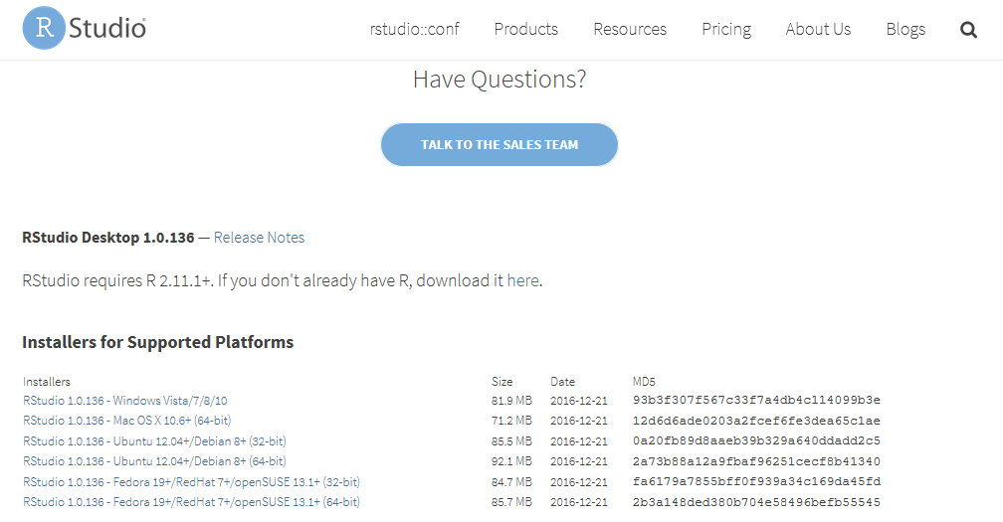
Downloading RStudio
Windows Version

Slide 14
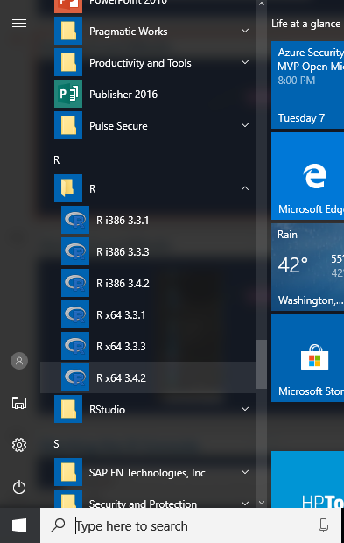
Starting R and RStudio
64 Bit Most Recent Version

Slide 15
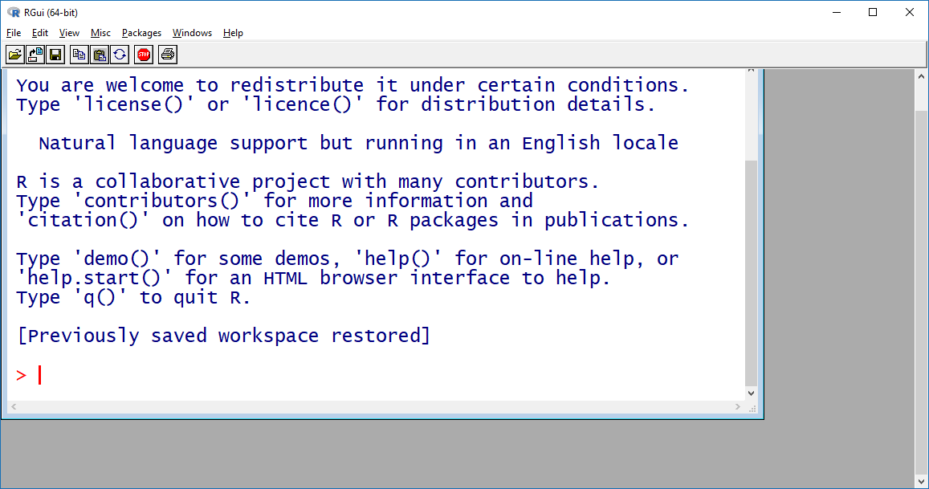
The R Console
Windows Version

Slide 16
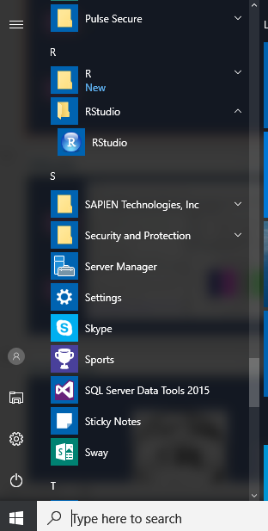
Starting R and RStudio
Start RStudio

Slide 17
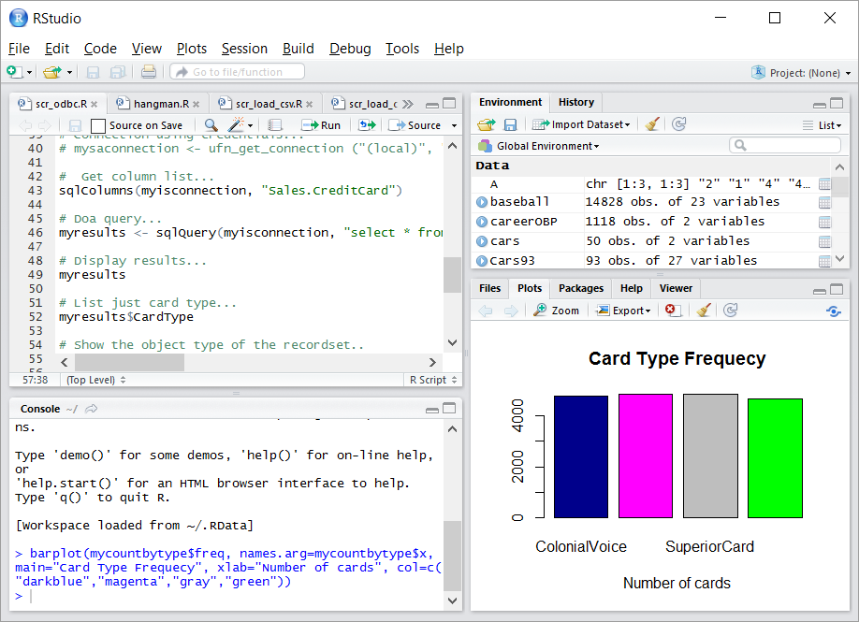
RStudio
Environment Memory
Script Editor
Tabbed Views
R Console

Slide 18
R Overview
A Tour of RStudio
Visualizations
Presentations
Shiny
https://shiny.rstudio.com/gallery
/
Part 1 Scripts

Slide 19
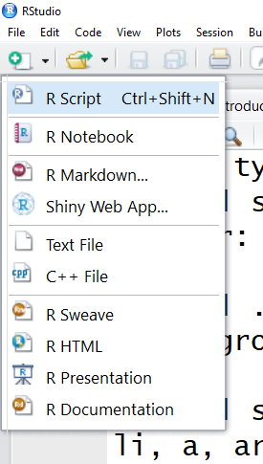
RStudio Features: Script Types
Standard R Script
Code and Output in One Document
Publishing
Interactive R Application
More Publishing

Slide 20
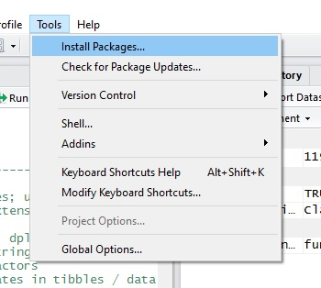
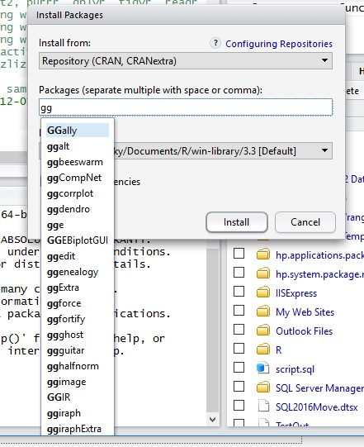
RStudio Features: Install Packages
Auto-Search

Slide 21
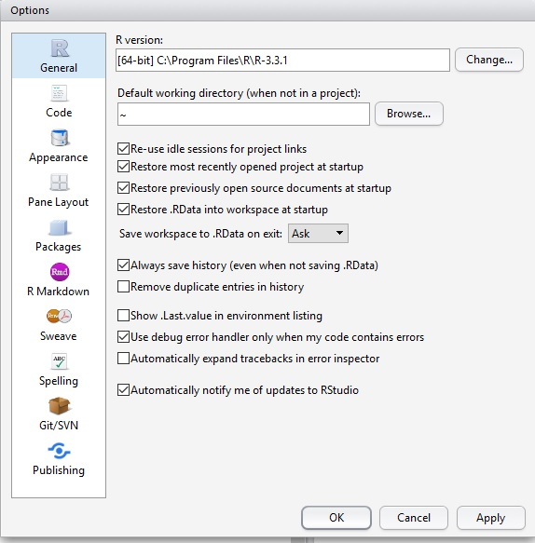
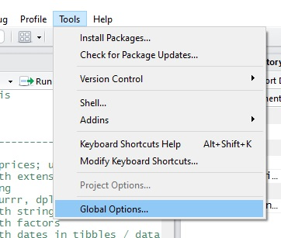
Review of Our Tour
RStudio Features: Options

Slide 22

Part 2: R Programming Primer
Basic Syntax
Vectors
Matrixes
Arrays
Lists
Data Frames

Slide 23
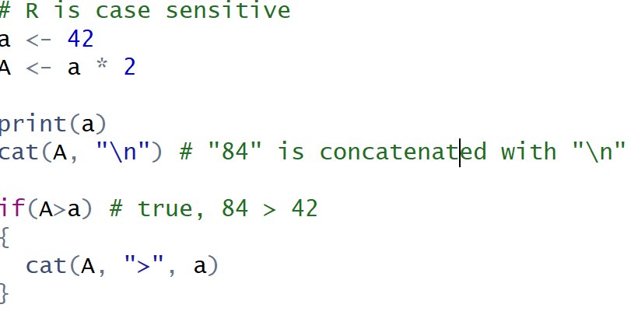
R Syntax
Case Sensitive – a is a different variable from A
Statements are function calls.
Braces mark blocks of code.

Slide 24
R Programming
Demo
Part 2 Scripts

Slide 25
R Processing is Vector Based
Most Programming Languages work on a single data element at a time called a scalar value, i.e. X = 5
R Inherently works on sets of data called vectors, i.e. X = 1,3,4,5. This makes R ideally suited for statistics.
A Set of Numbers Is Processed with No Need to Iterate.

Slide 26
Vector Types
Integer – values 1,2,4,5,-4
Numeric – values such as 1.2, -2.6, 33.234, 55.88
Character – values such as “a”, “b”, “Harry”
Logical – values TRUE, FALSE
Raw – values such as 28, 6f, 6e for binary storage
Complex – values such as 5 + 2i where i is imaginary units

Slide 27
Vector Types
class() function returns a vector’s data type.
is. series of functions test for the specific data type.
is.integer()
is.numeric()
is.character()
is.logical()
is.raw()
is.complex()

Slide 28
Categorical Variables
Sometimes statistical calculations need to be grouped by a category.
Examples include:
Average Sales by Payment Type
Population by State
Statistical calculations only deal with numbers. Descriptive, non numeric values, must be assigned a number to group them together for analysis.

Slide 29
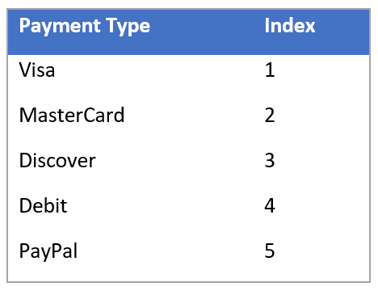
R Factor = Categorical Variable
In R, categorical variables are called Factors.
An example of how a factor works is below.
What’s Displayed
What’s Used In Calculations

Slide 30
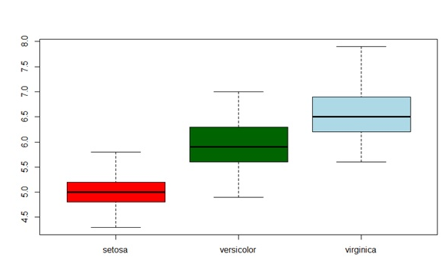
Factors in Use
Factors are used for grouping data as shown below.
The measure to plot
How to group the measure
boxplot(iris$Sepal.Length ~ iris$Species, col = c("red", "darkgreen", "lightblue"))

Slide 31

What is a Matrix?
A Matrix is a two dimensional vector.
It consists of columns are rows.
All elements of a matrix must be the same data type.

Slide 32
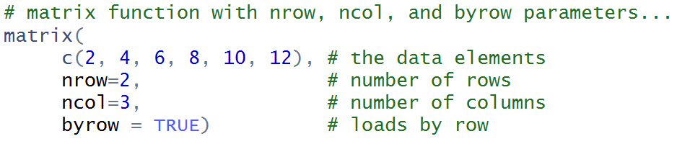
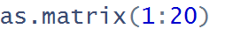
Creating a Matrix
Use the matrix function to create a matrix…
as.matrix only returns 1 column with one row per value…

Slide 33
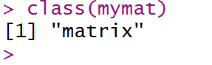
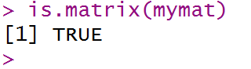
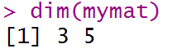
Matrix Functions
class returns the object type..
is.matrix returns TRUE if the parameter is a matrix
dim returns the number of rows and columns in the matrix

Slide 34
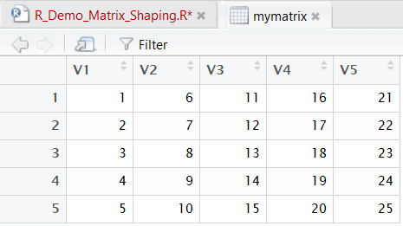
What is an Array?
An Array is a multidimensional vector.
Usually has three or more dimensions.
All elements of an array must be the same data type.

Slide 35
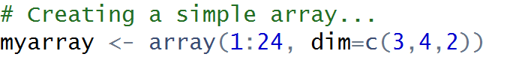
Creating an Array
Use the array function to create an array…

Slide 36
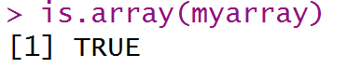
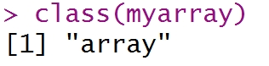
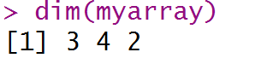
Array Functions
class returns the object type..
is.array returns TRUE if the parameter is an array
dim returns the number of rows and columns in the array

Slide 37
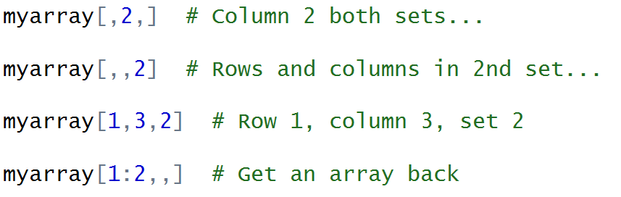
Accessing Array Elements

Slide 38
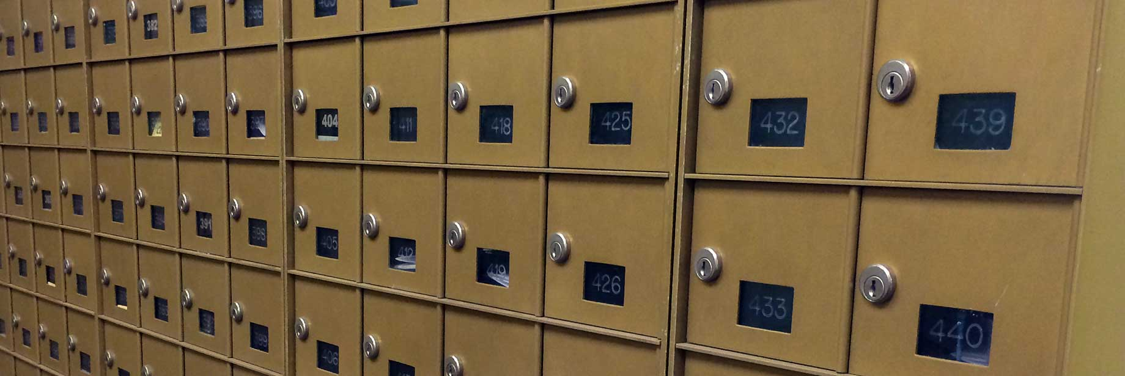
What is a List?
A vector of objects.
An object can be practically anything, i.e. a vector, matrix, array, another list.
Lists can be nested, i.e. can contain a lists which contains lists.
Are the basis for object orientated programming in R.
http://admin.utep.edu/Default.aspx?tabid=74353

Slide 39
Creating a List
Using the list function to create a list…

Slide 40

Data Frame
Data

Slide 41
Data Frame
An In Memory Table
Based on the List Object
Explicit and Implicit Data Frame Creation
Like a Matrix That Supports Different Data Types
Many Functions Support Data Frame Parameters

Slide 42
Creating a Data Frame
Explicitly using the data.frame function.
Implicitly when data is loaded by a function such as read.csv.

Slide 43
Data Frame
Demo
R_Demo_6_DataFrame_Intro.R

Slide 44
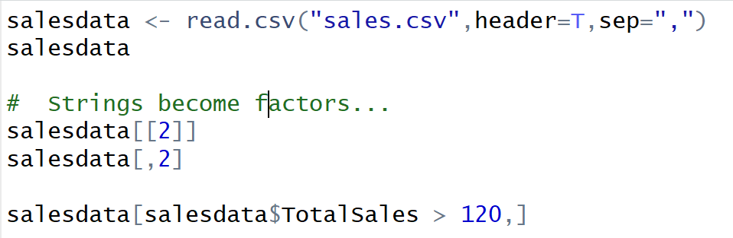
Data Frame

Slide 45
Functions
Defines a Block of Code That Can Be Called By Name
Avoids Repetition of Code
Can Be Called Any Number of Time
Information Can Be Passed to the Function as Parameters

Slide 46
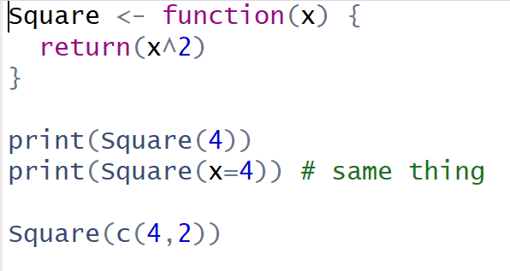
Functions
Function function returns a function
Defines function but does not execute it
Calling the function

Slide 47
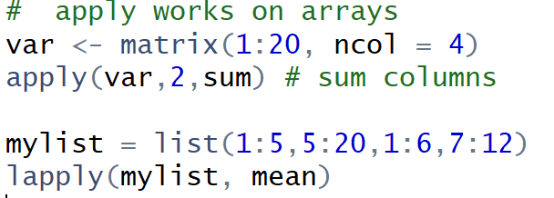
apply functions
Parameters:
Variable
1 for column, 2 for row
function
1st Letter indicates return type
List in, List out

Slide 48

Review of Our Tour
Packages

Slide 49
What is a Package?
A collection of functions and/or data that can be easily shared
Used to extend R capabilities
Community Developed
Downloaded from Repositories
A Library is the folder where the packages are stored

Slide 50
Installing a Package
Use the install.packages function to download and install from CRAN.
install.packages(“dplyr”)
To download and install from GitHub, you need to install “devtools”.
install.packages(“devtools”)
Then install packages from GitHub
library(“devtools”)
install_github("hadley/babynames")

Slide 51
Review of Our Tour
Installing Packages from Other Repositories
install_bioc()
install_bitbucket()
install_git()
install_local()
install_svn()
install_url()
install_version()

Slide 52
Review of Our Tour
Getting Help on Packages
Get Help in general
help.start() or help(functionname)
Get Help on how to use a package
help(package = "babynames")
View vignettes that explain the package
browseVignettes(package="dplyr")
View information all packages in CRAN
https://cran.r-project.org/web/packages/available_packages_by_name.html

Slide 53
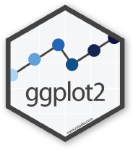
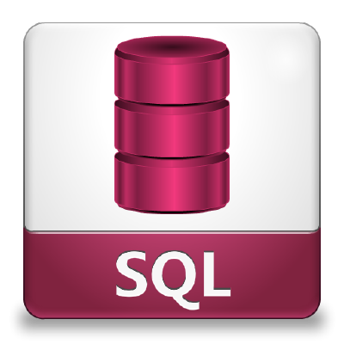

Package
Demo

Slide 54
Popular Packages: dplyr
Functions to manipulate data
Supports filtering, aggregating, sorting, grouping
Merge Data Sets
Create New Columns

Slide 55
Popular Packages: ggplot2
Supports Sophisticated Visualizations
Implements the Grammar of Graphics
Let’s Us Layer Our Graphics
Very Popular

Slide 56
Popular Packages: sqldf
Adds Structured Query Language (SQL) Support
Manipulate Data Without Learning New Functions
Easy to Use and Understand
Relies on SQLite

Slide 57
Packages
Demo
dplyr
Sqldf
ggplot2

Slide 58

Part 2: End

Slide 59
Background on Data Science
Statistics
Data Frame Shaping
Accessing Data
Data Quality & Wrangling

Slide 60
Background on Data Science
Statistics
Data Frame Shaping
Accessing Data
Data Quality & Wrangling

Slide 61

Statistics: What You Need to Know
Statistics Relationship to Data Science
What is Statistics?
Basic Concepts
Distribution & Standard Units

Slide 62
Data Science: Revolution or Evolution
Data Science is Not New! (S and SAS languages started in 1976)
Focus on and Explosion of Volume of Data – Requires Statistics
Faster Computers & Scaling Technologies / Cloud
New Hype = New Terms

Slide 63


Statistics & Data Science Roles
Data Scientist
Advanced Degree in Statistics
Research/Discovery Orientated
Conceptualize/Develop Models
Analyst
Has deep domain knowledge
Blends Operational Reporting & Analytics
Some Knowledge of Statistics
Less Complex Models/Solutions
Data Engineer
Focuses on Scaling Up/Out and Automation
May Modify Solution/Model to Scale It
Basic Understanding of Statistics and Models

Slide 64
Statistics & Data Science Roles
Business
Understanding
Modeling
Data Acquisition & Understanding
Deployment
A Team Based Perspective:
https://docs.microsoft.com/en-us/azure/machine-learning/data-science-process-overview

Slide 65

What is Statistics??
Collection
Analysis
Interpretation
Presentation
Insight

Slide 66
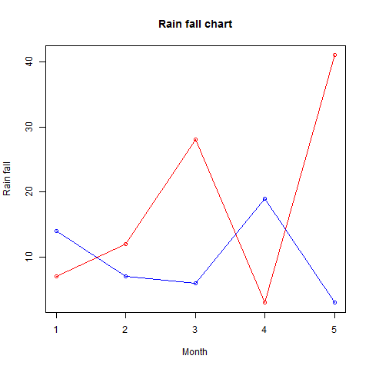
Relationships Between Variables
Age to Disease
Population to Crime
Drug to Recovery
Age, Education to Income

Slide 67
Concepts
Range – Difference between the lowest and highest value
Central Tendency – Point where the values tend to cluster.
Distribution – How the values spread out.
Outlier – An exceptionally large or small value.
Variance – How far the values are spread out.

Slide 68
Central Tendency
Mean (Average) = Sum of Values / Count of Values
(8 + 10 + 6 + 40 + 30) / 5 = 18.8
Median (Middle Value)
8, 10, 6, 40, 30
Sort Values Lowest to Highest
6, 8, 10, 30, 40
Median = Middle Value
Mode (Most Frequently Occurring Value)
Mode = 8
6, 8, 8, 8, 40

Slide 69
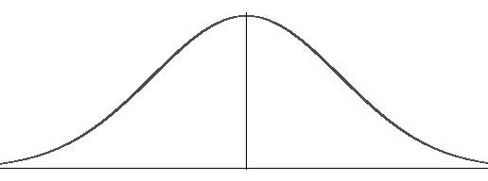
Quartiles
Splitting the Data Into Fourths
Normal
Distribution
25%
25%
25%
25%
Lowest
Q1
Q2
Q3
Q4
Highest

Slide 70
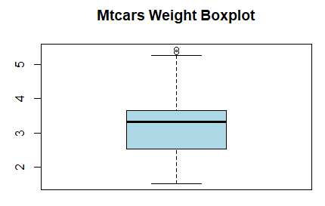
Using R to Visualize: Box Plot
Getting a sense of the range, distribution, and central tendency
Highest Value
3rd Quartile
Median
2nd Quartile
Lowest Value

Slide 71
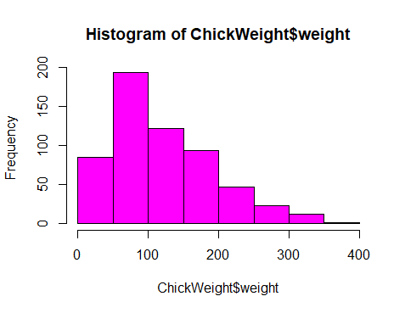
Distribution
What is Distribution?
Normal Distribution
Standard Units – Comparing Apples to Apples

Slide 72
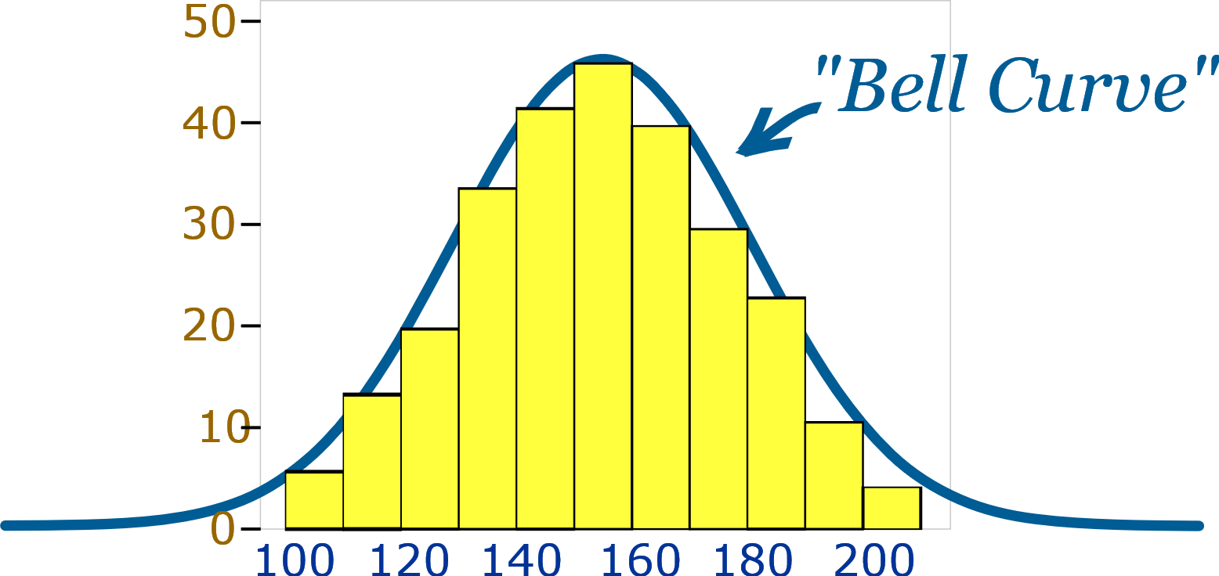
Normal Distribution
Values Cluster Towards the Center
Mean = Median = Mode
Symmetrical
Area Under the Curve Equals 1
Many Populations Have a Normal Distribution
https://www.mathsisfun.com/data/standard-normal-distribution.html

Slide 73
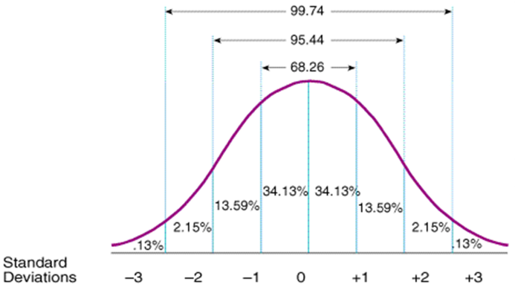
Standard Units
Must Have Normal Distribution
Calculate the Standard Deviation
The Standard Deviation is the Unit
The Mean is Zero
The Unit is Replaced with a Proportion
https://people.hofstra.edu/Cong_Liu/PSY40/8_Lab.html

Slide 74
Statistics
Demo

Slide 75
Review
Statistics Relationship to Data Science
What is Statistics?
Basic Concepts
Distribution & Standard Units

Slide 76

Part 3: Data Frame Shaping and Wrangling
Data

Slide 77
Data Frame Shaping
Add and Remove Columns
Add and Remove Rows
Update Values
Sorting
Dealing with missing values.

Slide 78
Data Frame Shaping
Demo

Slide 79
Data Frame Slicing & Filtering
We can access data.frame columns by name.
MyDataFrame$FirstName
We can access rows and columns by subscript.
MyDataFrame[,3]
The attach function makes referencing columns easier
attach(MyDataFrame)
print(FirstName)

Slide 80
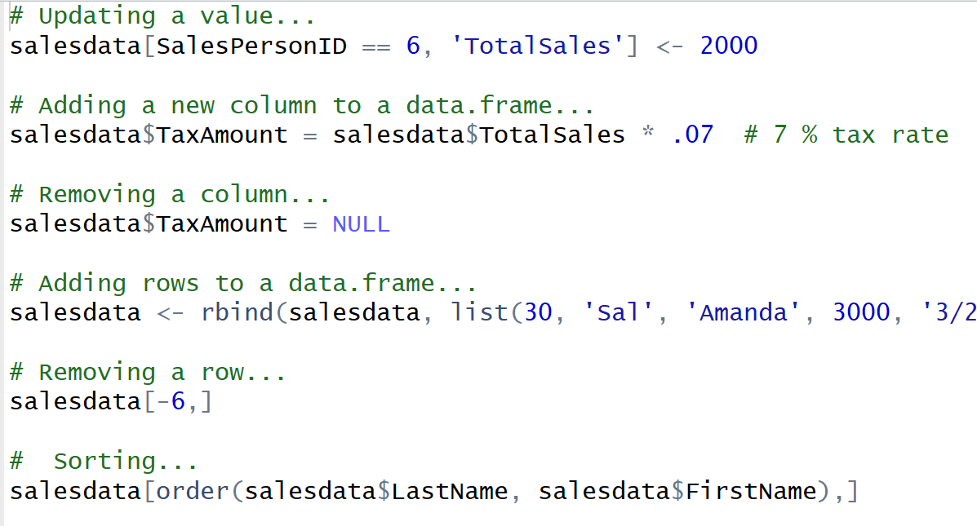
Data Frame Shaping

Slide 81
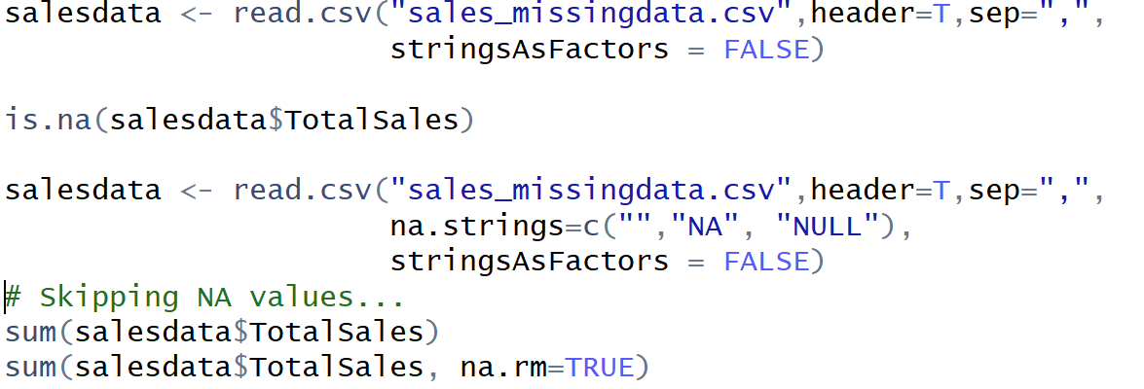
Data Frame: Handling Missing Data
Which values are missing?
Convert values to NA
Remove NA Values

Slide 82

Data Quality and Data Wrangling
Reasons for Incorrect and Missing Data
What’s the Impact?
Identification and Correction
Thoughts on Data Quality

Slide 83

Review
Data Frames – Slicing, Dicing
Data Frame Shaping
Handling Missing Values
Impact of Missing Data

Slide 84
End of Part 3

Slide 85

Data Relationships

Slide 86
Evaluating Data Relationships
Relationships Among Variables (Correlation)
Linear and Nonlinear Relationships
Correlation vs. Causality
Multivariate Correlation

Slide 87

Relationships Among Variables (Correlation)
Correlation is the Relationship Between the Value of Variables
Variables Tend to Change Together
Can We Use Historical Correlation to Estimate the Future Value of a Variable?

Slide 88
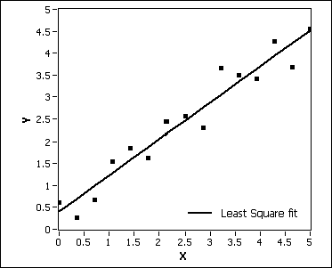
Correlation - Linear
Example: Gross Sales related to Profit, i.e. the more sales revenue, generally the more profit. Assume X is Sales and Y is profit over a series of years.
The points are the actual sales/profit. The line is attempting to get the average. This is an example of a linear relationship.

Slide 89
Understanding Correlation
Calculated as a Number Between 0 and 1
Zero Means No Relationship
One Means 100% Correlation
Negative Value Indicates an Inverse Relationship
Predictive Modeling with R 89

Slide 90
Correlation – Linear Relationship Examples
Foot size to height.
Study time to grades.
Distance to travel time.

Slide 91
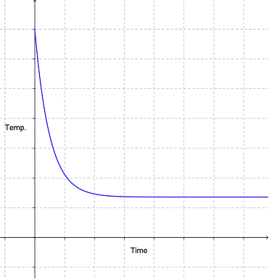
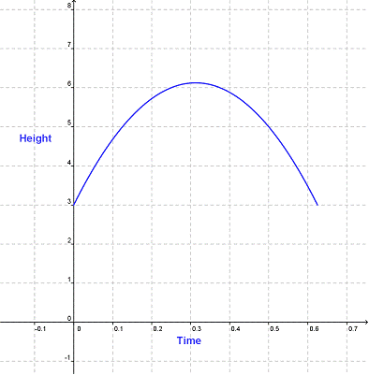
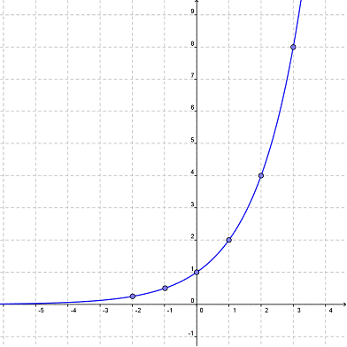
Non Linear Relationships
Do Not Have a Constant Slope
Cookies cooling time after baking
Thrown Ball Height Over Time
Population Growth
https://www.montereyinstitute.org/courses/Algebra1/COURSE_TEXT_RESOURCE/U03_L2_T5_text_final.html

Slide 92
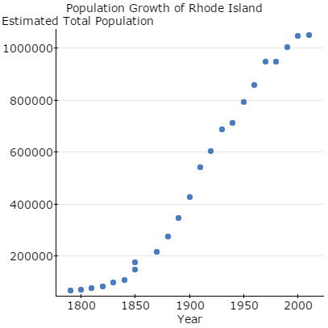
Determining the Type of Relationship
Scatterplots Can Help
Exponential Relationship
https://www.statcrunch.com/5.0/viewresult.php?resid=1656215

Slide 93
Multivariate Correlation
Using Multiple Variables Can Improve Correlation Strength
Inclusion of a Variable May Help or Hurt Predictive Effectiveness
Goal is to Find the Best Input Variables to Get Strongest Correlation

Slide 94
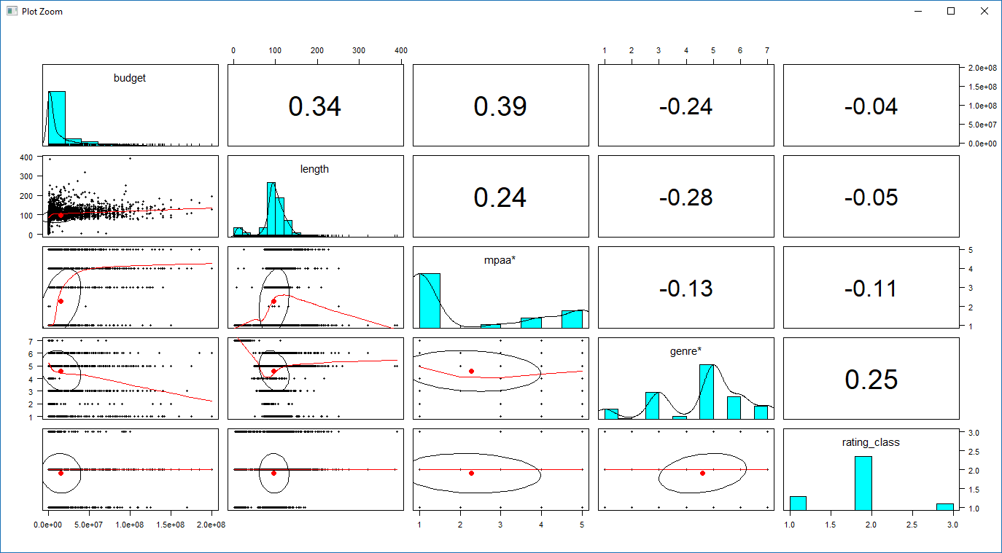
Review: Determining Correlation
library(psych)
pairs.panels(mymovies[,c('budget’, 'length’, ‘mpaa’, 'genre’, 'rating_class')])

Slide 95
Correlation Is Not Causation
Outcome Variable May Cause Input Variable
Confounders
Coincidence

Slide 96
Review
Relationships Among Variables
Linear and Nonlinear Relationships
Calculating Correlation
Correlation vs. Causality
Multivariate Correlation

Slide 97

Data Science
What is Data Science?
Machine Learning - Supervised and Unsupervised Learning
Predictive Modeling
Data Mining
Research

Slide 98
Data Science
What is Data Science?
Machine Learning - Supervised and Unsupervised Learning
Predictive Modeling
Data Mining
Research

Slide 99
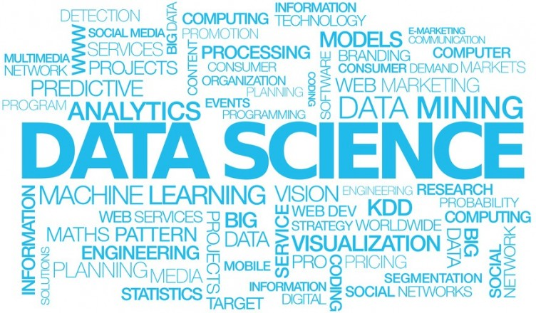
What is Data Science?
Machine Learning

Slide 100

What is Data Science?
Data science, also known as data-driven science, is an interdisciplinary field about scientific methods, processes, and systems to extract knowledge or insights from data in various forms, either structured or unstructured
How Can We Use the Inundation of Data to Learn New things.
https://en.wikipedia.org/wiki/Data_science

Slide 101
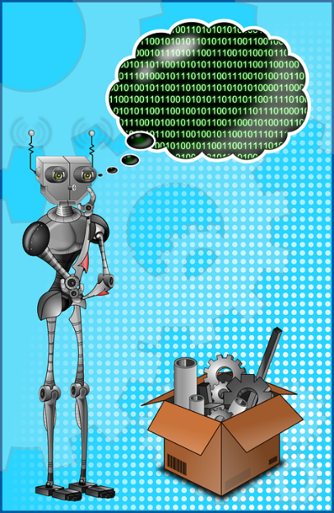
What is Machine Learning?
Branch of Artificial Intelligence that Allows Programs to Learn without Being Explicitly Programmed by Using Algorithms and Statistical Models.
Make Sense of the Many Various Forms and Volumes of Data.
Turn Data into Actionable Insights.

Slide 102

Unsupervised Learning
The Input Data is not Labeled, i.e. we don’t know what the data is.
The Goal is to Look for Patterns in the Data Such as Grouping, aka Clustering.
Example: Fraud Detection.

Slide 103

Predictive Modeling, Supervised Learning
Input Data is Fed into the Program
The Program is to Determine the Relationship Between the Input Columns and a Result Output Column
Based on Analysis of Inputs to Result, a Model is Created to Predict the Result Based on a Given Set of Inputs

Slide 104

Data Mining
Goal is to Find Patterns in the Data.
Can be Supervised or Unsupervised.
Result May Be Used to Create a Predictive Model.
Example: Market Basket Analysis.

Slide 105
Research/Population Comparison
Is a Pharmaceutical Effective?
Is the Lifestyle in Once Population Leading to Better Health?
Are Environmental Factors Affecting the Survival Rate of Possum?
Are Pesticides Negatively Impacting Consumers?
Goal: Prove a Hypothesis.

Slide 106
Review
What is Data Science?
Machine Learning - Supervised and Unsupervised Learning
Predictive Modeling
Data Mining
Research/Population Comparison

Slide 107
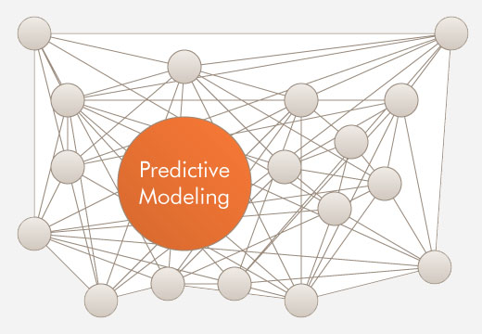

Slide 109
Creating a Predictive Model
What is a Predictive Model?
Identifying the Input Variables
Steps to Creating a Predictive Model
Evaluating the Model

Slide 110
What is Predictive Modeling?
Predictive Modeling attempts to determine an unknown variable based on known variables using probabilities.
Use the past to predict the future (Historical Data).
Use the Correlation between the Input Variables and the Variable to be predicted.

Slide 111
Applications of Predictive Modeling
Classify something such as is an is an email spam or ham?
What group does something belong to such as what species of plant?
Will a person contract a certain illness?
Will the patient be readmitted?
Is the person a high health risk?

Slide 112
Steps to Creating a Predictive Model
Analyze/Clean the Data
Determine the Columns that Predict the Answer
Select a Model to Use
Train the Model
Evaluate the Model’s Effectiveness
Use the Model

Slide 113
The Birth Weight (BirthWt) Data Set
Risk Factors Associated with Low Infant Birth Weight
Column | Meaning
age | mother's age in years.
lwt | mother's weight in pounds at last menstrual period.
race | mother's race (1 = white, 2 = black, 3 = other).
smoke | smoking status during pregnancy.
ptl | number of previous premature labors.
ht | history of hypertension.
ui | presence of uterine irritability.
ftv | number of physician visits during the first trimester.
bwt | birth weight in grams.
low | indicator of birth weight less than 2.5 kg.

Slide 114

Steps to Predictive Modeling

Slide 115
Demo
Demo – Part 4
Creating a Predictive Model
Based on the following sources:
https://www.r-bloggers.com/using-decision-trees-to-predict-infant-birth-weights/
http://blog.revolutionanalytics.com/2013/06/plotting-classification-and-regression-trees-with-plotrpart.html

Slide 116

Review: Extracting the Training/Testing Data

Slide 117

Review: Viewing the Decision Tree
library(rpart)
birthwtTree <- rpart(low ~ . - bwt,
data = birthwt[train, ],
method = 'class')
# Plot the Decision Tree
library(rattle)
fancyRpartPlot(birthwtTree,
main="Birth Weight")

Slide 118


Review: Evaluating the Model

Slide 119
Review
What is a Predictive Model?
Identifying the Input Variables
Steps to Creating a Predictive Model
Evaluating the Model

Slide 120
End of Part 4 - Predictive Modeling

Slide 121

SQL Server/R Integration

Slide 122
R Limitations
Client side only tool. No server based processing.
Data limited by client memory.
Single threaded.
Database data must be imported to be used.
Relatively slow.
No scheduling tool.

Slide 123
Microsoft buys Revolution Analytics
Proprietary vendor providing scalability options.
Support for multi-threading.
Provide a shared R server.
Performant versions of common R functions.
Data not limited by memory.

Slide 124
SQL Server 2016: Reaching R's Potential
Stored procedures can be coded in R with the features that entails.
SQL Server and R share memory space.
Work can be split between SQL Server and R Server.

Slide 125

SQL Server Plus R = Value

Slide 126

SQL Server: R Operationalized
https://msdn.microsoft.com/en-us/library/mt590947.aspx

Slide 127

SQL Server: R Operationalized
https://www.youtube.com/watch?v=by2cJ9sQO0Q

Slide 128

SQL Server/R Architecture
https://www.youtube.com/watch?v=by2cJ9sQO0Q

Slide 129
Microsoft R Open
R Open - an open source R distribution from Microsoft that is fixed stable release.
CRAN is always adding updates to the R language which can be unstable.
Some enhanced performance math functions are included.
Is used in place of the standard CRAN R language download.
Must be used with R scalability features.

Slide 130
Microsoft R Client
Is a set of R packages.
Implements RScale functions but with limited scalability.
Useful for learning and development.
May be a good option when small only scale improvments are needed.

Slide 131
Microsoft R Server
Like an Express Edition of R Server.
A stand alone R execution environment.
Clients submit R requests to R Server for high speed processing.
Can be contained within other environments such as SQL Server.
Versions for Linux, Hadoop and Teradata.
Tight integration with SQL Sever.

Slide 132
Microsoft R Open
Proprietary high performance functions used in place of the standard R functions.
Start with the prefix 'rx', i.e. rxImport.
Can be used with Microsoft R Client (free) or R Server but severly limited scalability on R Client.
scaleR Functions https://msdn.microsoft.com/en-us/microsoft-r/scaler/scaler

Slide 133
SQL Server: DeployR
Known as the R Integration Server.
An optional framework for deploying R analytics inside web, desktop, mobile, and dashboard applications as well as backend systems.
Provides analytics services such as a predictive model as a web service.
Used on Azure Machine Learning.

Slide 134
Must Install Needed Packages

Slide 135

SQL Server Launchpad Service

Slide 136
Demo
SQL Server R Services Demo
Prerequisites. script_1_PreReq_for_DS_Step1.R
Client side use of rx functions.script_2_scaleup.R
Predictive Model Development Walk Through. script_3_RSQL_Walkthrough_final.R

Slide 137
Q & A

Slide 138
End of Part 5 - SQL Server/R Integration

Slide 139
Supercharing Power BI with R

Slide 140

The Story of the Five Iron

Slide 141

Power BI with R

Slide 142

Using R with Power BI

Slide 143

It was rumored that the Apple logo was in honor of this pioneer of Computer Science.

Slide 144
It was rumored that the Apple logo was in honor of this pioneer of Computer Science.
Alan Turing – an apple with a bite out of it was found next to him.

Slide 145
Why Use R?
Can do things in Power BI that cannot be done without it.
Tell stories involving machine learning.
Show the research, i.e. how did we get here.
Extend your skillset.
Data Exploration.

Slide 146


Enabling R Scripts
Select Options

Slide 147


Power BI R Script as a Data Source

Slide 148

Power BI R Script as a Data Source
Load an installed package.
Function returns a data frame.
New data frame based on value_adjusted
Remove unneeded data frame.

Slide 149

Power BI R Script as a Data Source

Slide 150

Power BI R Script as a Data Source

Slide 151
Demo
Loading Data from an R Script
r_adjusted_values_load.r

Slide 152

Windows with AI Enabled

Slide 153

Transformation Script
Click on Edit Queries

Slide 154

Transformation Script
Click on Transform
Click on Run R Script

Slide 155

Transformation Script
Power BI Passed Data In as the dataset data frame.
Data is returned via the output data frame.

Slide 156
Demo
Transforming Data from an R Script
scr_transformation.r
Scr_power_bi_sales_adjusted_measure

Slide 157

Visualizations with R
Click on R

Slide 158

Visualizations with R
Expand Code Window

Slide 159

Visualizations with R
Data passed to Script as dataset data frame.

Slide 160

Visualizations with R
Packages must be installed.
Code renders visualization.

Slide 161

Visualizations with R
Run Script
Script Options
Go To R IDE
Expand/Contract Script Pane

Slide 162
Demo
Loading Data from an R Script
r_visualization.r

Slide 163
Visualizations with R

Slide 164

Visualizations with R
Click to Edit R Script

Slide 165
Demo with Predictive Model

Slide 166
Data Sources
Built In R Data
data()
MRAN
R Packages that Get Data
https://mran.microsoft.com/documents/data/
http://blog.revolutionanalytics.com/2016/01/new-data-sources-for-r.html

Slide 167
Review
R is a popular open source data science language.
The Comprehensive R Archive Network (CRAN) maintains R.
R has rich support for statistics and visualizations.
R is a vectorized language.
R is Extended with new Functionality via Packages.

Slide 168
End of Part 6 – Power BI with R

